Slide 1
CYBER SECURITY ATTACK ANALYSIS

Slide 2
Introduction
Enhancing Cybersecurity for Small Businesses
Analyze a synthetic cyber dataset containing 40,000 entries from January 1, 2020, to October 11, 2023.
Assessing cybersecurity threats and vulnerabilities.
Identifying prevalent attack types and patterns.
Investigating anomaly scores and alerts to detect potential threats.
Developing comprehensive incident response plans and implementing robust security measures.
Objective: Enable small businesses to enhance their cybersecurity defenses and protect sensitive information.
Dataset is taken from Kaggle ➸ https://www.kaggle.com/datasets/teamincribo/cyber-security-attacks/data

Slide 3
Exploratory Data Analysis
Examining Missing Values
We've identified significant missing values in several columns of our cybersecurity dataset, containing 40,000 rows and 25 columns. Here's a breakdown of the most concerning columns:
* Alerts/Warnings: **50.17%** (20,067 missing values)
* IDS/IPS Alerts: **50.13%** (20,050 missing values)
* Malware Indicators: **50.00%** (20,000 missing values)
* Firewall Logs: **49.90%** (19,961 missing values)
* Proxy Data: **49.63%** (19,851 missing values)
As you can see, these columns have a substantial amount of missing data, potentially impacting our analysis. We'll address these missing values in the next steps to ensure robust and reliable results.

Slide 4
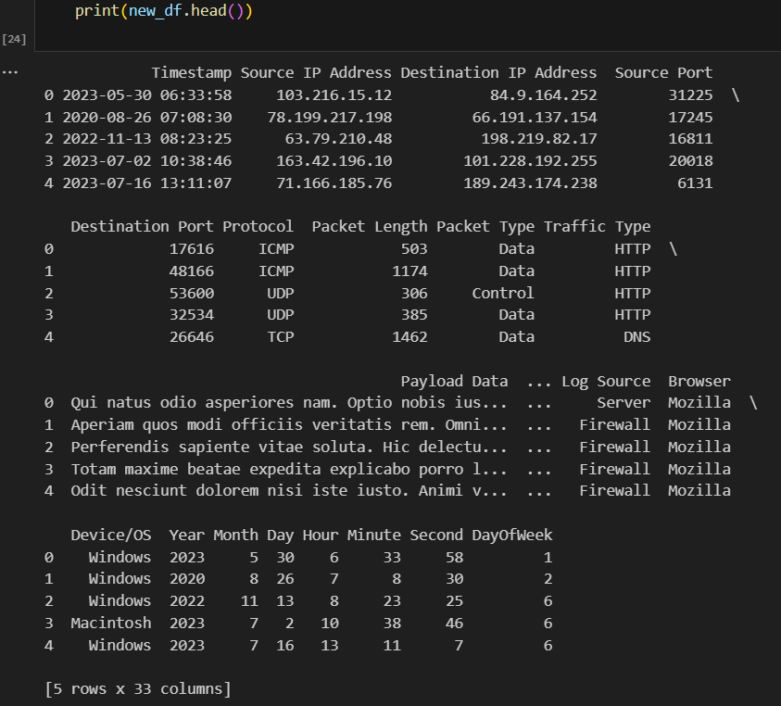
Preprocessed Data

Slide 5
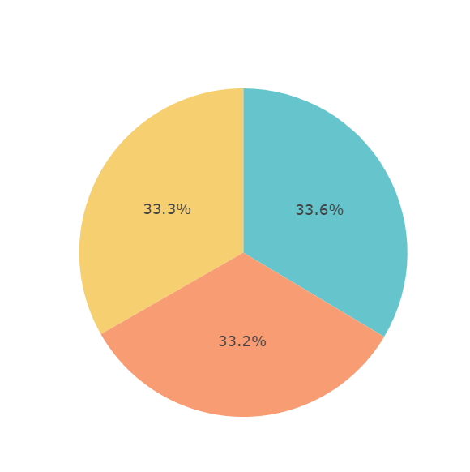
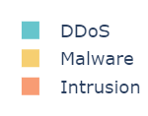
Data Visualization
Prevalent Attack Types:
Malware infections targeting business systems.
Phishing attacks aimed at extracting sensitive information.
Distributed Denial of Service (DDoS) attacks disrupting network services.
Anomalies:
High anomaly scores indicating unusual and potentially malicious network activities.
Alerts corresponding with significant spikes in network traffic or unusual login attempts.

Slide 6
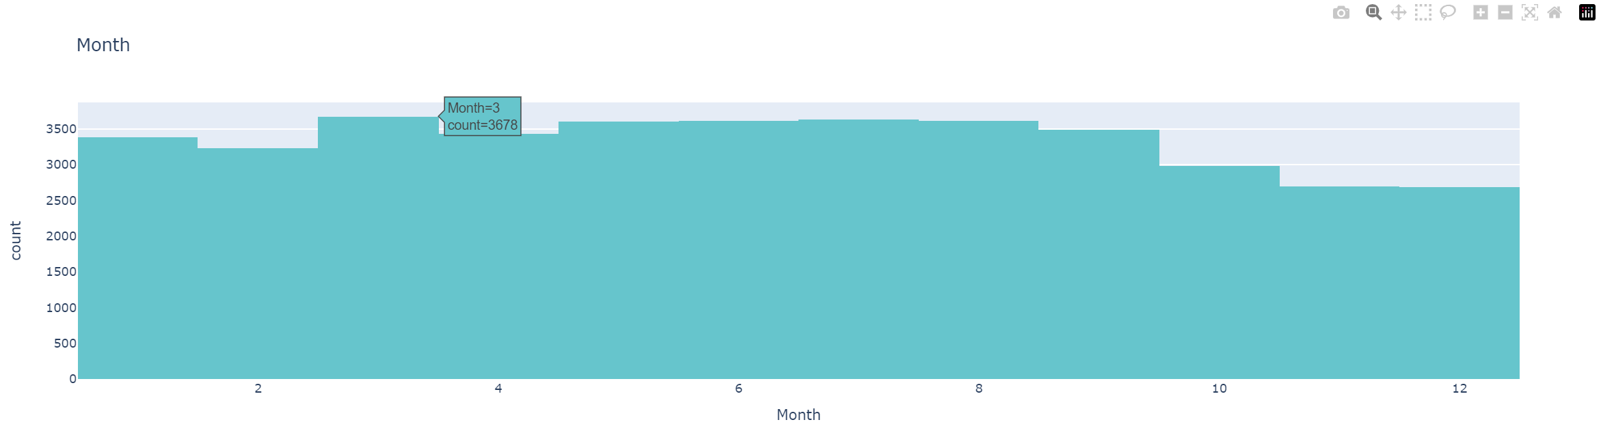
Key Findings
Patterns:
Increased frequency of attacks on specific dates and months, indicating potential seasonal or event-driven attack strategies.
The histogram explains the attacks being done on organization in a year. Among which, the organization has experienced highest number of attacks in the month of March with the count of 3,678.

Slide 7
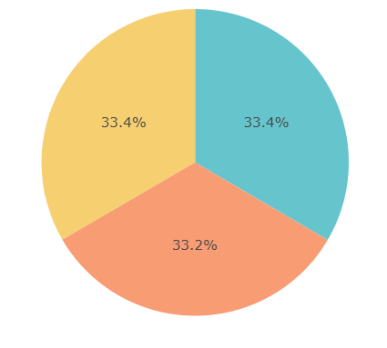

Analyze the Traffic Type
The pie chart reveals an almost similar distribution of traffic types: DNS (33.4%), HTTP (33.4%), and FTP (33.2%). This suggests that the three traffic categories are being used in a balanced manner.
DNS (Domain Name System):
DNS translates domain names (like www.example.com) into IP addresses. DNS allows users to access websites using easy-to-remember names instead of numerical IP addresses.
HTTP (Hypertext Transfer Protocol):
HTTP is used to transmit web pages and web content over the internet.
FTP (File Transfer Protocol):
FTP transfers files between a client and a server on a network. Common uses of FTP include uploading website files to a server and sharing files between computers.

Slide 8
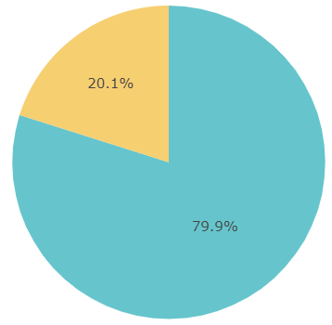

Analyzing the Browser Attack Types
The "Browser Distribution" pie chart shows that Mozilla is used by 20.1% of users, while other browsers account for 79.9%. This shows that, while considerable, Mozilla is not the most popular browser among users, with the majority choosing alternative options.

Slide 9
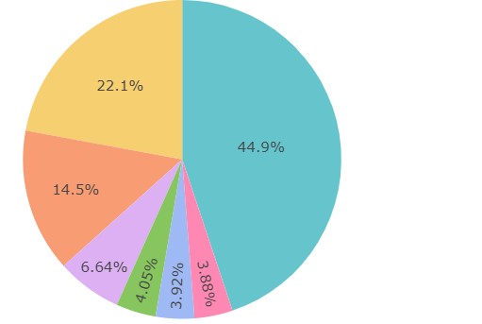
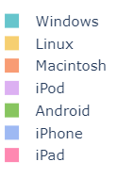
Analyzing the Devices Attack Types
The chart shows the distribution of different platforms on the smartphone market. Android has the largest market share with 46.7%, followed by iOS with 23%. Windows, Linux, Macintosh, and iPod platforms all have a market share of less than 7% each.

Slide 10
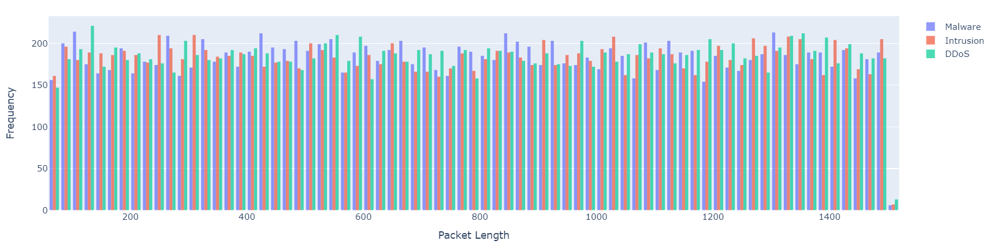
Distribution for Various Attack Types
The histogram shows the packet length distributions for Malware, Intrusion, and DDoS attacks. Malware has a definite peak, while intrusion has greater variability, and DDoS has clustered patterns, providing insights into attack characteristics for focused security methods.

Slide 11
Recommendations Overview
01
04
02
05
03
06
Threat Intelligence Gathering
Endpoint Security Solutions
Vulnerability Assessment
Cybersecurity Policy Development
Security Awareness Training
Incident Response Planning

Slide 12
Recommendations
SECURITY
COMPANY
Threat Intelligence Gathering
Real-Time Monitoring: Automate threat detection and updates.
Collaboration: Join cybersecurity communities for shared insights.
Contextual Analysis: Analyze threats with global events and trends.
Vulnerability Assessment
Regular Assessments: Conduct frequent scans and tests.
Risk Management: Prioritize risks by impact and likelihood.
Security Awareness Training
Tailored Programs: Role-specific training for all employees.
Phishing Simulations: Regular simulations to improve awareness.
Endpoint Security Solutions
Advanced Protection: Deploy and update antivirus and firewalls.
Cross-Platform Security: Secure all devices, including less common ones.
Cybersecurity Policy Development
Clear Policies: Document roles and procedures clearly.
Regular Updates: Review and update policies regularly.
Incident Response Planning
Detailed Plans: Create comprehensive response plans.
Regular Drills: Conduct drills to ensure effective response.

Slide 13
Conclusion
Proactive Measures:
Strategic Defense:
Implementing these recommendations can significantly enhance the organization's security posture.
A proactive approach helps in early detection and prevention of cyber threats.
Protecting the business’s reputation, customer trust, and financial stability is crucial.
Strategic deployment of resources and continuous improvement are key to maintaining robust cybersecurity.

